Slide 1
Internal Memory

Slide 2

Semiconductor Memory

Slide 3
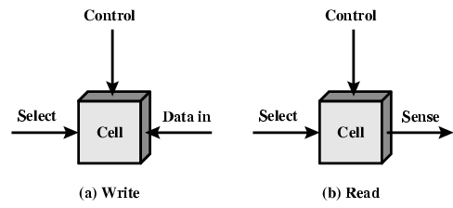
Memory Cell Operation
address
address

Slide 4
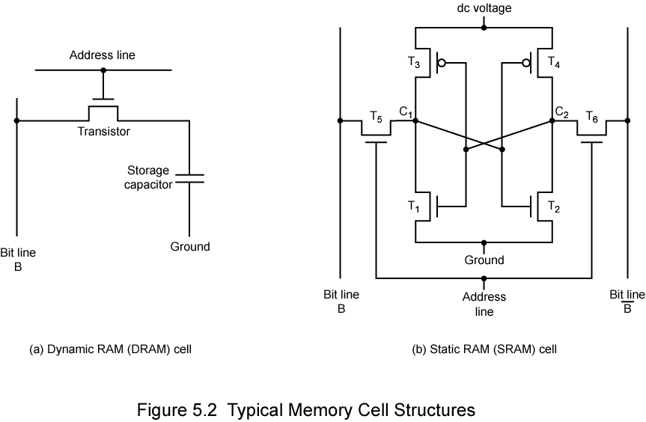
Dynamic RAM | static RAM
Bit stored as charge in capacitors | Bits stored as on/off switches
Need refreshing though powered, due to refresh circuits and charge leak | No charges to leak, No refreshing needed when powered and no refreshing circuit(flip-flops)
Simper construction, less expensive, but slower | More complex construction, More expensive, Faster
Use for main memory,(Larger memory units) | Use for cache

Slide 5
DRAM Operation
Address line active when bit read or written
  Transistor switch closed (current flows)
Write
  Voltage is applied to bit line, High for 1 low for 0
  Then signal is address line
    Transfers charge to capacitor
Read
  Address line selected
    transistor turns on
  Charge from capacitor fed via bit line to sense amplifier
    Compares with reference value to determine 0 or 1
  Capacitor charge must be restored

Slide 6
Static RAM Operation
Transistor arrangement gives stable logic state
State 1
  C₁ high, C₂ low
  T₁ T₄ off, T₂ T₃ on
State 0
  C₂ high, C₁ low
  T₂ T₃ off, T₁ T₄ on
Address line transistors T₅ T₆ is switch
Write – apply value to B & compliment to B
Read – value is on line B
Without address line, T5,T6 are off to reserve

Slide 7
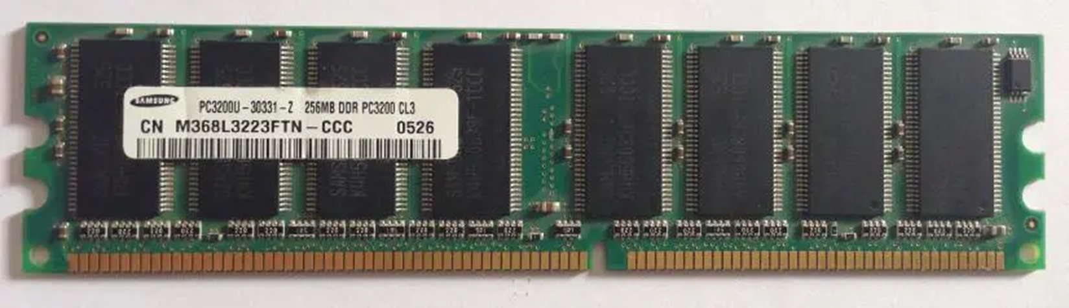

Slide 8
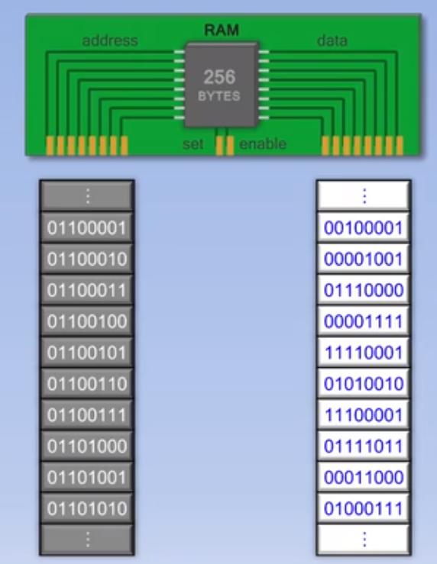
Address
Data

Slide 9
Read Only Memory (ROM)
Permanent storage
  Nonvolatile
Systems programs (BIOS)
Function tables

Slide 10
Types of ROM(BIOS on board)
Written during manufacture
  Very expensive for small runs
Programmable (once)
  PROM
  Needs special equipment to program
Read “mostly”
  Erasable Programmable (EPROM)
    Erased by UV
  Electrically Erasable (EEPROM)
    Takes much longer to write than read
  Flash memory
    Erase whole memory electrically

Slide 11
Organisation in detail
A 16Mbit chip can be organised as 1M of 16 bit words
A bit per chip system has 16 lots of 1Mbit chip with bit 1 of each word in chip 1 and so on
A 16Mbit chip can be organised as a 2048 x 2048 x 4bit array
  Reduces number of address pins
    Multiplex row address and column address
    11 pins to address (2¹¹=2048)
    Adding one more pin doubles range of values so x4 capacity(Use more address line)

Slide 12
Refreshing
Refresh circuit included on chip
Disable chip
Count through rows
Read & Write back
Takes time
Slows down apparent performance

Slide 13
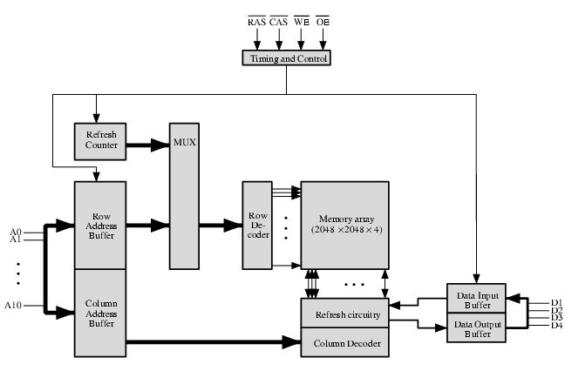
Typical 16 Mb DRAM (4M x 4)
1M need 20 条线
Number of address N
Address range: 2^{N}
2048 x 2048 x 4bit array

Slide 14
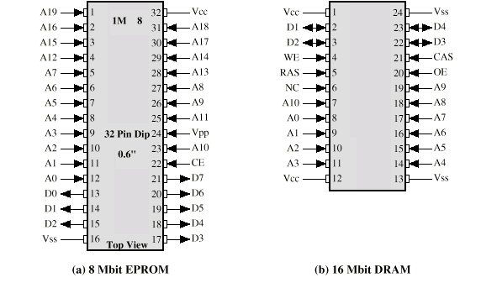
Packaging

Slide 15
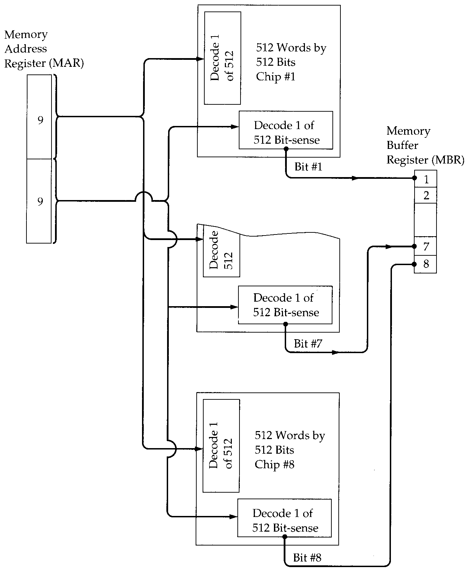
256kByte Module
Organisation
Row
Column
512*512*8bits

Slide 16
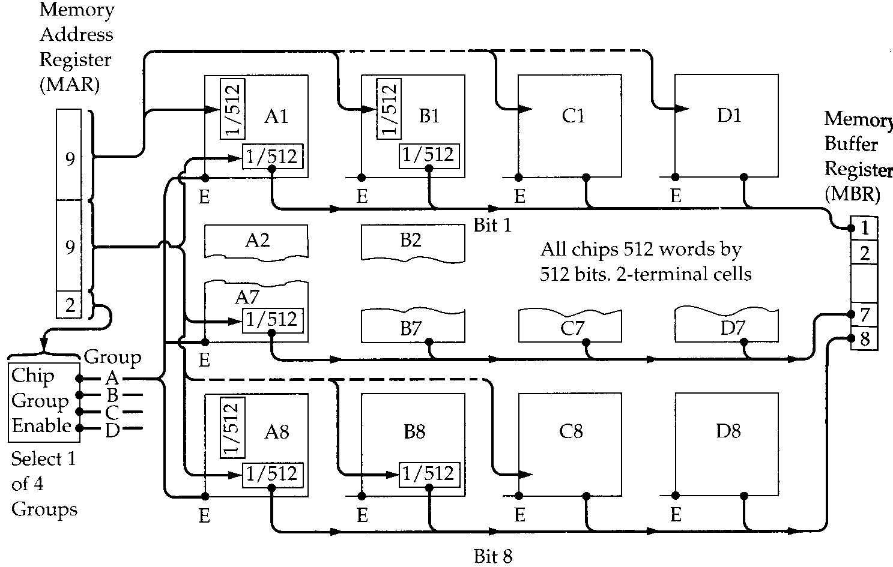
1MByte Module Organisation
512*512*4(chips)*8bits
Row
Column
CS

Slide 17
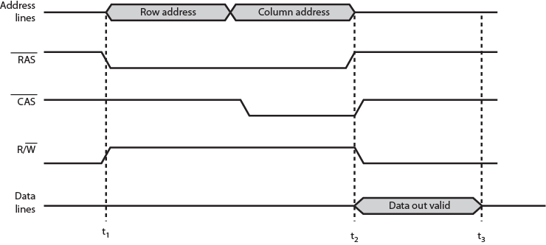
Simplified DRAM Read Timing

Slide 18
External Memory

Slide 19
Types of External Memory
Magnetic Disk
  RAID
  Removable
Optical
  CD-ROM
  CD-Recordable (CD-R)
  CD-R/W
  DVD
Magnetic Tape

Slide 20
Magnetic Disk
Disk substrate coated with magnetizable material (iron oxide…rust)
Substrate used to be aluminium
Now glass
  Improved surface uniformity
    Increases reliability
  Reduction in surface defects
    Reduced read/write errors
  Lower flight heights (See later)
  Better stiffness
  Better shock/damage resistance

Slide 21
Read and Write Mechanisms
Recording & retrieval via conductive coil called a head
May be single read/write head or separate ones
During read/write, head is stationary, platter rotates
Write
  Current through coil produces magnetic field
  Pulses sent to head
  Magnetic pattern recorded on surface below
Read (traditional)
  Magnetic field moving relative to coil produces current
  Coil is the same for read and write
Read (contemporary)
  Separate read head, close to write head
  Partially shielded magneto resistive (MR) sensor
  Electrical resistance depends on direction of magnetic field
  High frequency operation
    Higher storage density and speed

Slide 22
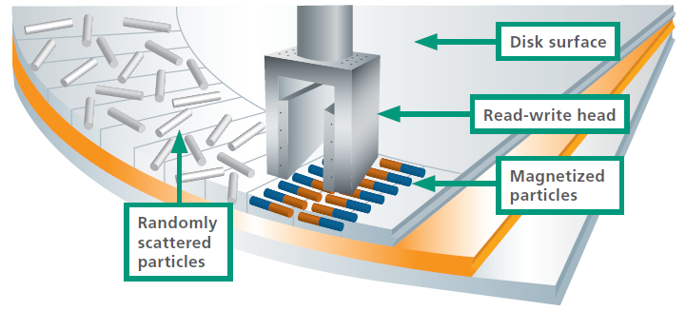
Inductive Write MR Read

Slide 23
Data Organization and Formatting
Concentric rings or tracks
  Gaps between tracks
  Reduce gap to increase capacity
  Same number of bits per track (variable packing density)
  Constant angular velocity
Tracks divided into sectors
Minimum block size is one sector
May have more than one sector per block

Slide 24

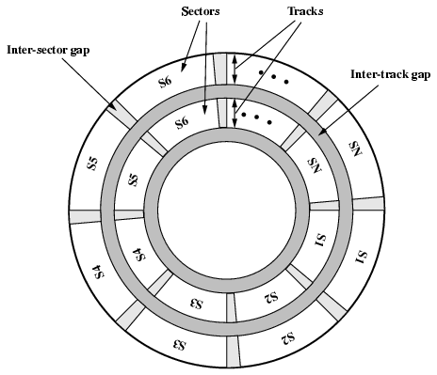

Slide 25
Finding Sectors
Must be able to identify start of track and sector
Format disk
  Additional information not available to user
  Marks tracks and sectors

Slide 26
Multiple Platter
One head per side
Heads are joined and aligned
Aligned tracks on each platter form cylinders
Data is striped by cylinder
  reduces head movement
  Increases speed (transfer rate)

Slide 27
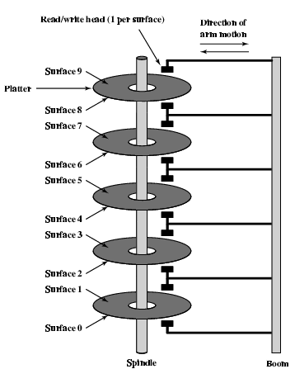
Multiple Platters

Slide 28
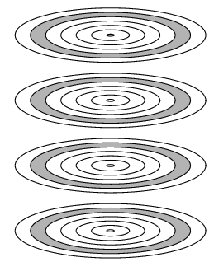
Tracks and Cylinders

Slide 29
RAID
Redundant Array of Independent Disks
Redundant Array of Inexpensive Disks
6 levels in common use
Not a hierarchy
Set of physical disks viewed as single logical drive by O/S
Data distributed across physical drives
Can use redundant capacity to store parity information

Slide 30
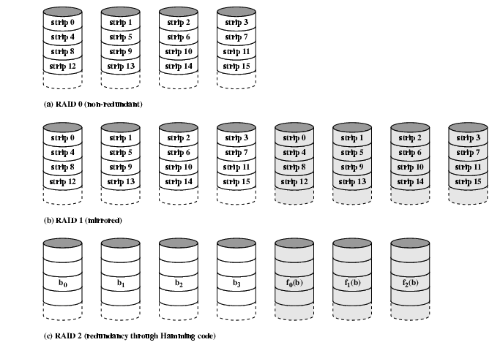
RAID 0, 1, 2

Slide 31
RAID 0
No redundancy
Data striped across all disks
Round Robin striping
Increase speed
  Multiple data requests probably not on same disk
  Disks seek in parallel
  A set of data is likely to be striped across multiple disks

Slide 32
RAID 1
Mirrored Disks
Data is striped across disks
2 copies of each stripe on separate disks
Read from either
Write to both
Recovery is simple
  Swap faulty disk & re-mirror
  No down time
Expensive

Slide 33
RAID 0, 1, 2

Slide 34
Optical Storage CD-ROM
Originally for audio
650Mbytes giving over 70 minutes audio
Polycarbonate coated with highly reflective coat, usually aluminium
Data stored as pits
Read by reflecting laser
Constant packing density
Constant linear velocity

Slide 35
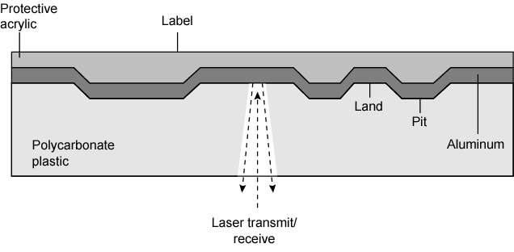
CD Operation

Slide 36
Other Optical Storage
CD-Recordable (CD-R)
  Compatible with CD-ROM drives
CD-RW
  Erasable
  Getting cheaper
  Mostly CD-ROM drive compatible

Slide 37
DVD - what’s in a name?
Digital Video Disk
  Used to indicate a player for movies
    Only plays video disks
Digital Versatile Disk
  Used to indicate a computer drive
    Will read computer disks and play video disks

Slide 38
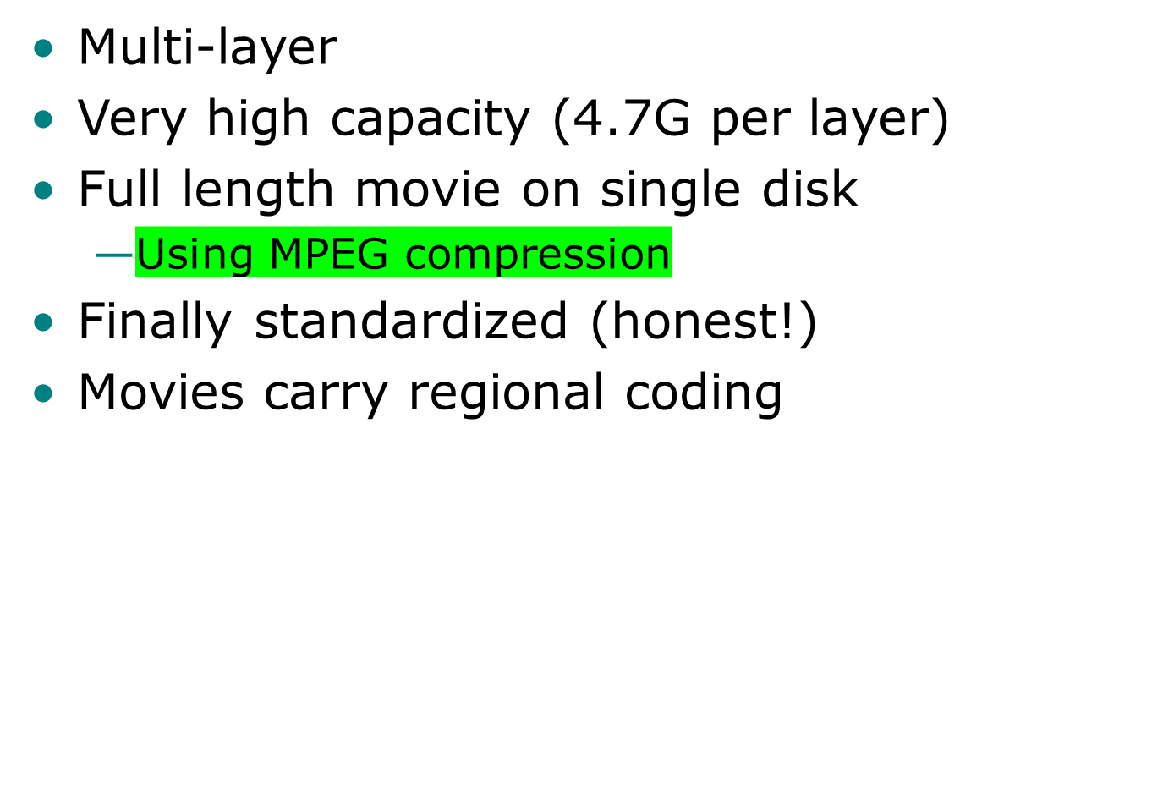
DVD - technology

Slide 39
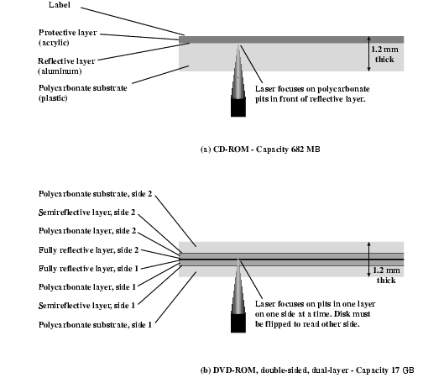
CD and DVD

Slide 40
High Definition Optical Disks
Designed for high definition videos
Much higher capacity than DVD
  Shorter wavelength laser
    Blue-violet range
  Smaller pits
HD-DVD
  15GB single side single layer
Blue-ray
  Data layer closer to laser
    Tighter focus, less distortion, smaller pits
  25GB on single layer
  Available read only (BD-ROM), Recordable once (BR-R) and re-recordable (BR-RE)

Slide 41
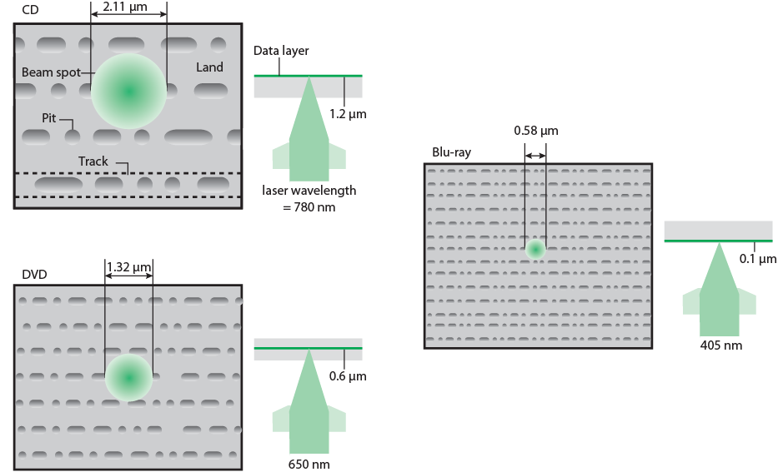
Optical Memory Characteristics

Slide 42
Magnetic Tape
Serial access
Slow
Very cheap
Backup and archive

Slide 43
Solid State Storage Technology
Solid state storage (sometimes called flash memory) stores data in erasable, rewritable circuitry, rather than on spinning disks or streaming tape
Once the data is stored it is non-volatile, meaning the circuits retain data without an external power source

